Slide 1
Queries-OutPuts

Slide 2
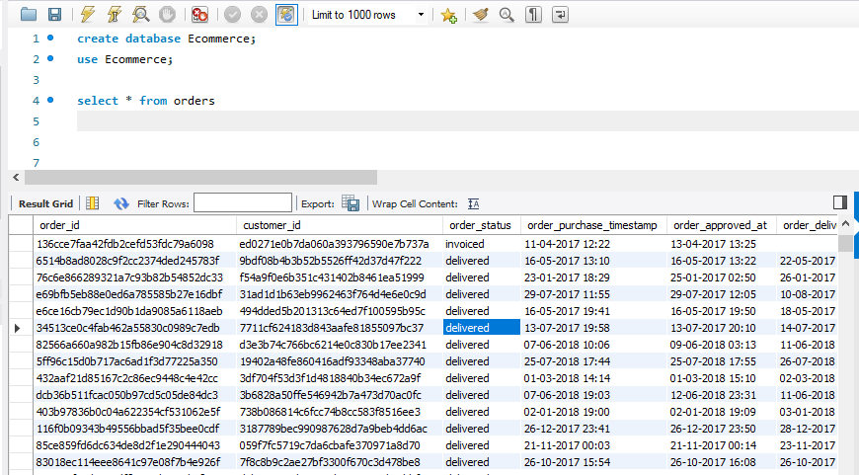
Question 1- Use Select

Slide 3
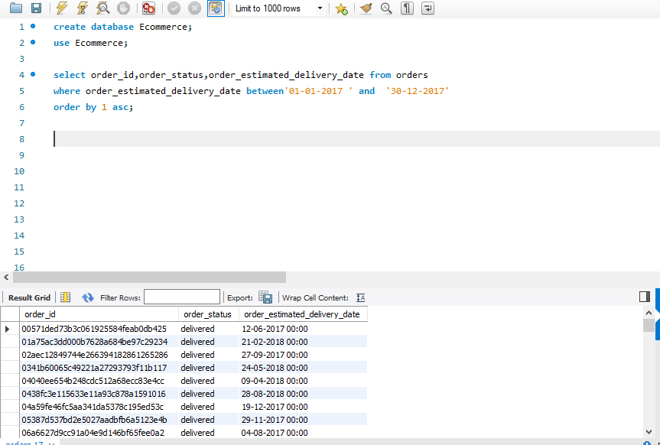
Question 1- Use Where

Slide 4
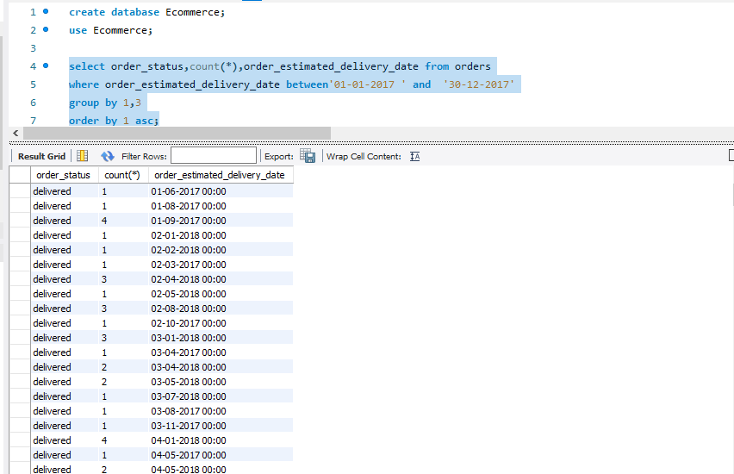
Question 1- Use Where ,Group by and order by

Slide 5
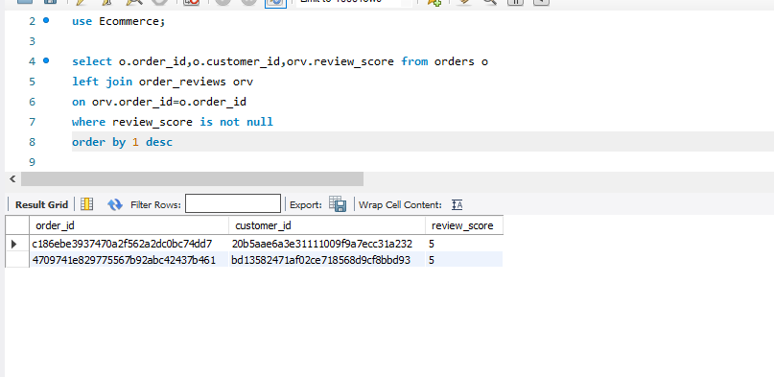
Question 2- Use left Join

Slide 6
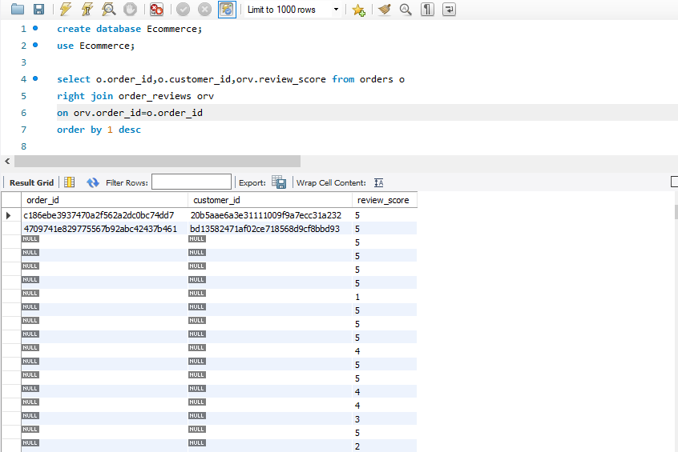
Question 2- Use Right Join

Slide 7
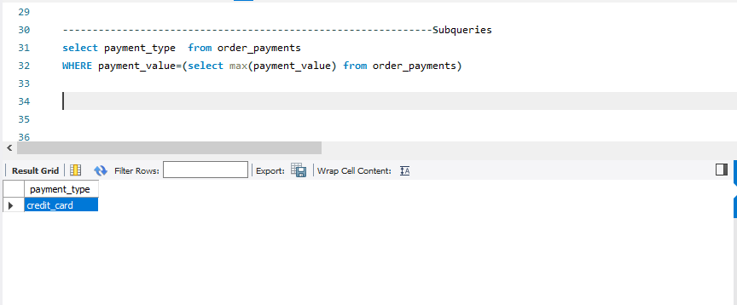
Question 3- Use subquries

Slide 8
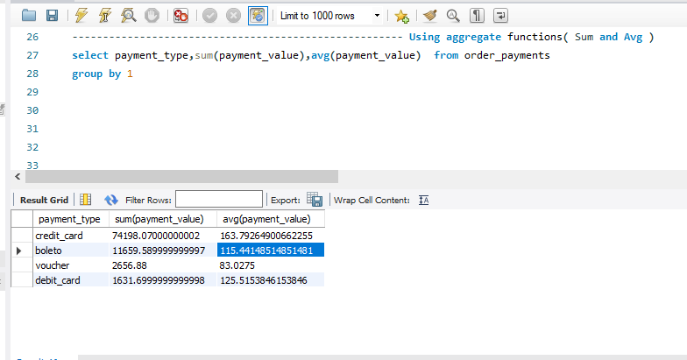
Question 4- Use Aggregate function Sum and Avy

